Slide 1

Big Data Infrastructure
Session 7: Extending MapReduce
Jimmy Lin
University of Maryland
Monday, March 23, 2015
This work is licensed under a Creative Commons Attribution-Noncommercial-Share Alike 3.0 United States See http://creativecommons.org/licenses/by-nc-sa/3.0/us/ for details

Slide 2
Today’s Agenda
Making Hadoop more efficient
Tweaking the MapReduce programming model
Setup for… What’s beyond MapReduce?

Slide 3

Hadoop is slow...
Source: Wikipedia (Tortoise)

Slide 4
A Major Step Backwards?
MapReduce is a step backward in database access:
Schemas are good
Separation of the schema from the application is good
High-level access languages are good
MapReduce is poor implementation
Brute force and only brute force (no indexes, for example)
MapReduce is not novel
MapReduce is missing features
Bulk loader, indexing, updates, transactions…
MapReduce is incompatible with DMBS tools
Source: Blog post by DeWitt and Stonebraker

Slide 5
Hadoop vs. Databases: Grep
SELECT * FROM Data WHERE field LIKE ‘%XYZ%’;
Source: Pavlo et al. (2009) A Comparison of Approaches to Large-Scale Data Analysis. SIGMOD.

Slide 6
Hadoop vs. Databases: Select
SELECT pageURL, pageRank
FROM Rankings WHERE pageRank > X;
Source: Pavlo et al. (2009) A Comparison of Approaches to Large-Scale Data Analysis. SIGMOD.

Slide 7
Hadoop vs. Databases: Aggregation
SELECT sourceIP, SUM(adRevenue)
FROM UserVisits GROUP BY sourceIP;
Source: Pavlo et al. (2009) A Comparison of Approaches to Large-Scale Data Analysis. SIGMOD.

Slide 8
Hadoop vs. Databases: Join
Source: Pavlo et al. (2009) A Comparison of Approaches to Large-Scale Data Analysis. SIGMOD.

Slide 9

Jeff Hammerbacher, Information Platforms and the Rise of the Data Scientist. In, Beautiful Data, O’Reilly, 2009.
“On the first day of logging the Facebook clickstream, more than 400 gigabytes of data was collected. The load, index, and aggregation processes for this data set really taxed the Oracle data warehouse. Even after significant tuning, we were unable to aggregate a day of clickstream data in less than 24 hours.”

Slide 10
Why?
Integer.parseInt
String.substring
Source: Wikipedia (Tortoise)

Slide 11
Schemas are a good idea!
Parsing fields out of flat text files is slow
Schemas define a contract, decoupling logical from physical

Slide 12
Thrift
Originally developed by Facebook, now an Apache project
Provides a DDL with numerous language bindings
Compact binary encoding of typed structs
Fields can be marked as optional or required
Compiler automatically generates code for manipulating messages
Provides RPC mechanisms for service definitions
Alternatives include protobufs and Avro

Slide 13
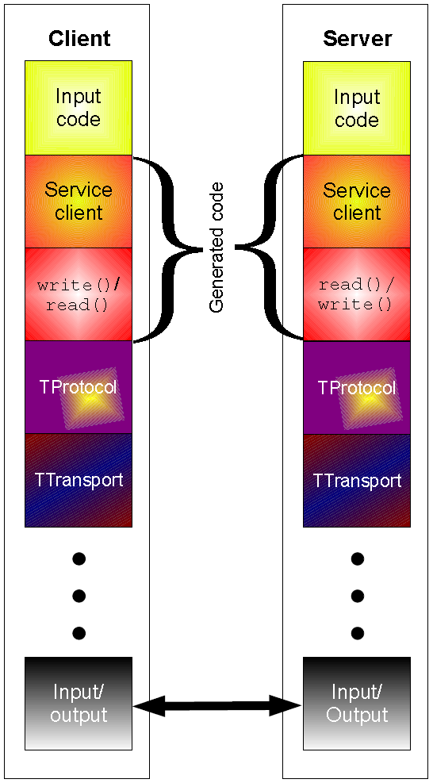
Thrift
struct Tweet {
1: required i32 userId;
2: required string userName;
3: required string text;
4: optional Location loc;
}
struct Location {
1: required double latitude;
2: required double longitude;
}

Slide 14
Why not…
XML or JSON?
REST?

Slide 15
Logical
Physical

Slide 16
Row vs. Column Stores
R₁
R₂
R₃
R₄
Row store
Column store

Slide 17
Row vs. Column Stores
Row stores
Easy to modify a record
Might read unnecessary data when processing
Column stores
Only read necessary data when processing
Tuple writes require multiple accesses

Slide 18
OLTP/OLAP Architecture
OLTP
OLAP
ETL (Extract, Transform, and Load)

Slide 19
Advantages of Column Stores
Read efficiency
Better compression
Vectorized processing
Opportunities to operate directly on compressed data

Slide 20
Why not in Hadoop?
No reason why not!
RCFile
Source: He et al. (2011) RCFile: A Fast and Space-Efficient Data Placement Structure in MapReduce-based Warehouse Systems. ICDE.

Slide 21
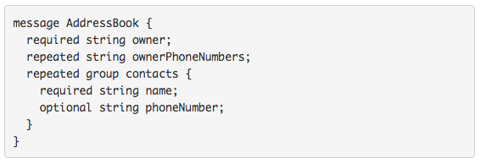
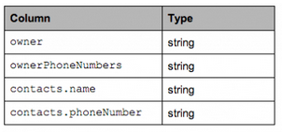
What about semi-structured data?
Required: exactly one occurrence
Optional: 0 or 1 occurrence
Repeated: 0 or more occurrences
Columnar Decomposition
What’s the issue?

Slide 22
What’s the solution?
Google’s Dremel storage model
Open-source implementation in Parquet
Source: https://blog.twitter.com/2013/dremel-made-simple-with-parquet

Slide 23
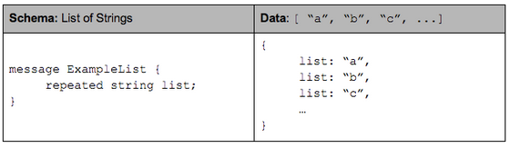
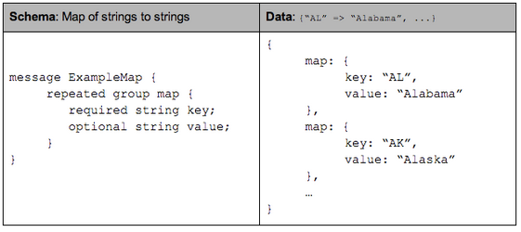
Optional and Repeated Elements

Slide 24
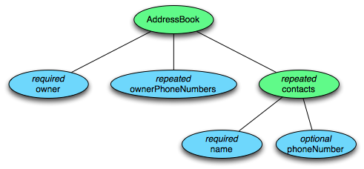
Tree Decomposition
Columnar Decomposition
What other information do we need to store?

Slide 25
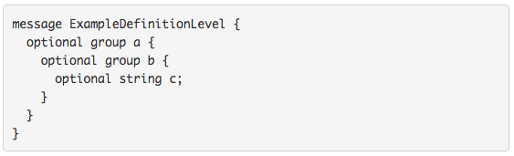
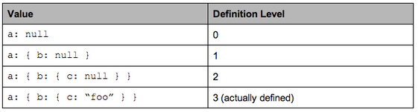
Definition Level

Slide 26
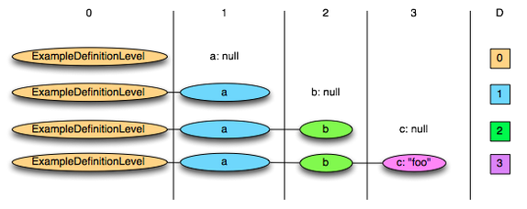
Definition Level: Illustration

Slide 27
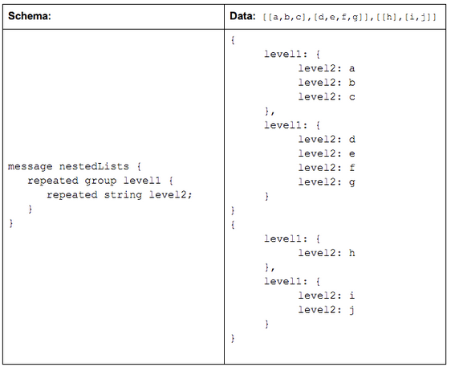
Repetition Level

Slide 28
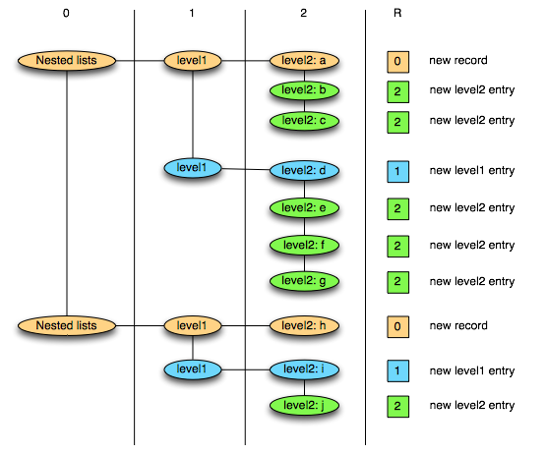
Repetition Level: Illustration
0 marks new record and implies creating a new level1 and level2 list
1 marks new level1 list and implies creating a new level2 list as well.
2 marks every new element in a level2 list.

Slide 29
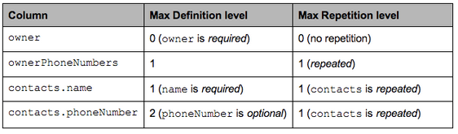
Putting It Together
Columnar Decomposition

Slide 30
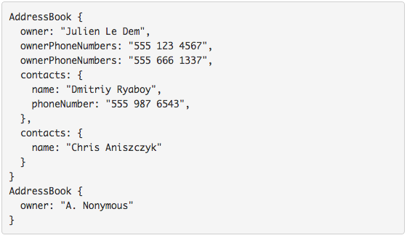
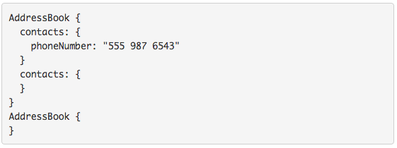
Sample Projection
Project onto contacts.phoneNumber

Slide 31
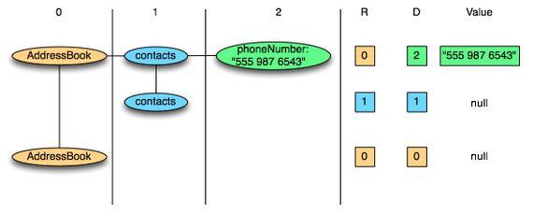
Physical Layout
Columnar Decomposition
Efficient Representations?

Slide 32
Key Ideas
Separate logical from physical
Preserve HDFS block structure
Hide physical storage layout behind InputFormats

Slide 33

Indexes are a good thing!
Source: Wikipedia (Card Catalog)

Slide 34

Why not in Hadoop?
No reason why not!
Non-invasive: requires no changes to Hadoop infrastructure
Useful for speeding up selections on joins
Indexing building itself can be performed using MapReduce
Source: Dittrich et al. (2010) Hadoop++: Making a Yellow Elephant Run Like a Cheetah (Without It Even Noticing). VLDB.

Slide 35
Hadoop + Full-Text Indexes
status = load ’/tables/statuses/2011/03/01’
using StatusProtobufPigLoader()
as (id: long, user_id: long, text: chararray, ...);
filtered = filter status by text matches ’.*\\bhadoop\\b.*’;
…
Pig performs a brute force scan
Stupid.
Then promptly chucks out most of the data
Source: Lin et al. (2011) Full-Text Indexing for Optimizing Selection Operations in Large-Scale Data Analytics. MAPREDUCE Workshop.

Slide 36
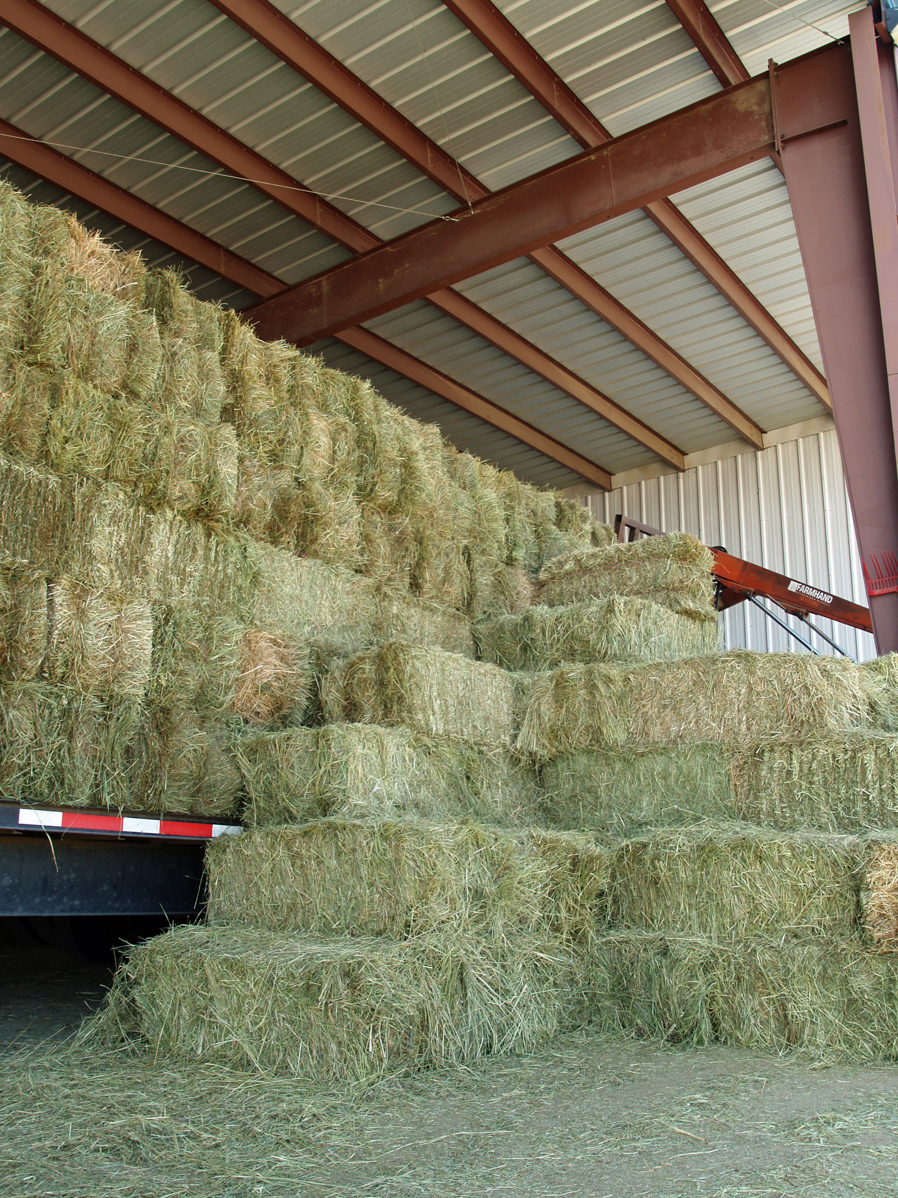
“Trying to find a needle in a haystack… with a snowplow”
@squarecog

Slide 37
Hadoop + Full-Text Indexes
status = load ’/tables/statuses/2011/03/01’
using StatusProtobufPigLoader()
as (id: long, user_id: long, text: chararray, ...);
filtered = filter status by text matches ’.*\\bhadoop\\b.*’;
…
Pig performs a brute force scan
Stupid.
Then promptly chucks out most of the data
Uhhh… how about an index?
Use Lucene full-text index

Slide 38
Client
LZO blocks
…
…
InputSplit
InputSplit
InputSplit
Mapper
Mapper
Mapper

Slide 39
Index-time
Lucene
Index
…
…
LZO blocks
…
…
Index for selection on tweet content
Build “pseudo-document” for each Lzo block
Index pseudo-documents with Lucene

Slide 40
Run-time
Lucene
Index
Client
LZO blocks
…
…
InputSplit
InputSplit
InputSplit
Mapper
Mapper
Mapper
Only process blocks known to satisfy selection criteria

Slide 41
Hadoop Integration
Everything encapsulated in the InputFormat
RecordReaders know what blocks to process and skip
Completely transparent to mappers

Slide 42
Experiments
Selection on tweet content
Varied selectivity range
One day sample data (70m tweets, 8/1/2010)

Slide 43
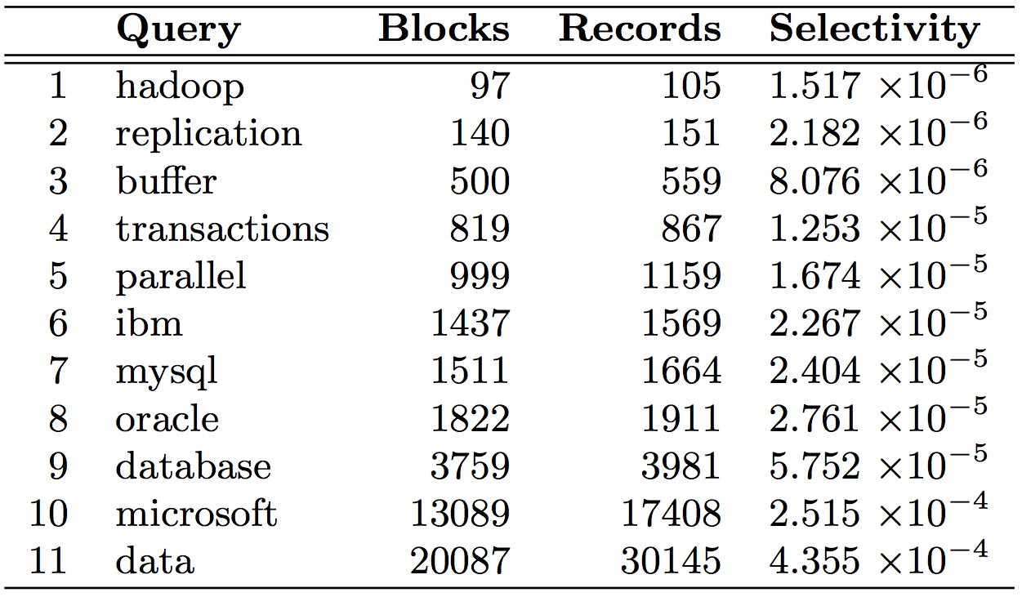

Slide 44
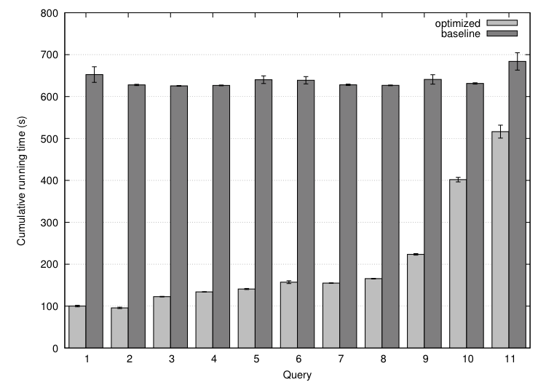

Slide 45
Analytical model
Task: prediction LZO blocks scanned by selectivity
Poisson model: P(observing k occurrences in a block)
E(fraction of blocks scanned):

Slide 46
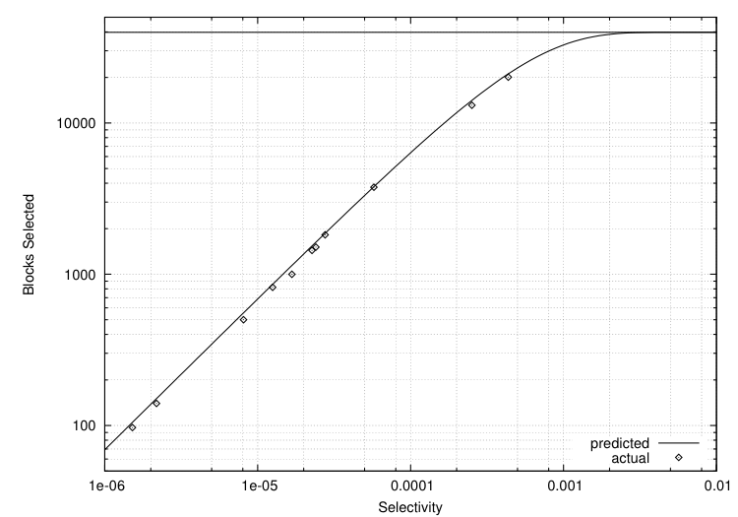
Selectivity 0.001 → 82% of all blocks
Selectivity 0.002 → 97% of all blocks
Total: ~40k blocks
But: can predict a priori!

Slide 47
Key Ideas
Separate logical from physical
Preserve HDFS block structure
Hide physical storage layout behind InputFormats

Slide 48
A Major Step Backwards?
MapReduce is a step backward in database access:
Schemas are good
Separation of the schema from the application is good
High-level access languages are good
MapReduce is poor implementation
Brute force and only brute force (no indexes, for example)
MapReduce is not novel
MapReduce is missing features
Bulk loader, indexing, updates, transactions…
MapReduce is incompatible with DMBS tools
✔
✔
?
✔
?
Source: Blog post by DeWitt and Stonebraker

Slide 49

“there are known knowns; there are things we know we know. We also know there are known unknowns; that is to say we know there are some things we do not know. But there are unknown unknowns – the ones we don't know we don't know…” – Donald Rumsfeld
Source: Wikipedia

Slide 50
Known and Unknown Unknowns
Databases are great if you know what questions to ask
“Known unknowns”
What if you don’t know what you’re looking for?
“Unknown unknowns”

Slide 51

Tweaking Hadoop
Source: Wikipedia (Chisel)

Slide 52
MapReduce Hybrids
Proposed fixes to problems with MapReduce
Mainly presented for historical interest…

Slide 53
Hadoop + DBs = HadoopDB
Why not have the best of both worlds?
Parallel databases focused on performance
Hadoop focused on scalability, flexibility, fault tolerance
Key ideas:
Co-locate a RDBMS on every slave node
To the extent possible, “push down” operations into the DB
Source: Abouzeid et al. (2009) HadoopDB: An Architectural Hybrid of MapReduce and DBMS Technologies for Analytical Workloads. VLDB.

Slide 54
HadoopDB Architecture
Source: Abouzeid et al. (2009) HadoopDB: An Architectural Hybrid of MapReduce and DBMS Technologies for Analytical Workloads. VLDB.

Slide 55
HadoopDB: Query Plans
SELECT YEAR(saleDate), SUM(revenue)
FROM sales GROUP BY YEAR(saleDate);
Source: Abouzeid et al. (2009) HadoopDB: An Architectural Hybrid of MapReduce and DBMS Technologies for Analytical Workloads. VLDB.

Slide 56
MapReduce Sucks: Iterative Algorithms
Java verbosity
Hadoop task startup time
Stragglers
Needless data shuffling
Checkpointing at each iteration

Slide 57
HaLoop: MapReduce + Iteration
Programming Model
Source: Bu et al. (2010) HaLoop: Efficient Iterative Data Processing on Large Clusters. VLDB.

Slide 58
HaLoop Architecture
Source: Bu et al. (2010) HaLoop: Efficient Iterative Data Processing on Large Clusters. VLDB.

Slide 59
HaLoop: Loop Aware Scheduling
Source: Bu et al. (2010) HaLoop: Efficient Iterative Data Processing on Large Clusters. VLDB.

Slide 60
HaLoop: Optimizations
Loop-aware scheduling
Caching
Reducer input for invariant data
Reducer output speeding up convergence checks
Source: Bu et al. (2010) HaLoop: Efficient Iterative Data Processing on Large Clusters. VLDB.

Slide 61
HaLoop: Performance
Source: Bu et al. (2010) HaLoop: Efficient Iterative Data Processing on Large Clusters. VLDB.

Slide 62

Beyond MapReduce…
Source: Wikipedia (Demolition)

Slide 63
Hadoop Cluster Architecture
namenode
job submission node
namenode daemon
jobtracker
tasktracker
tasktracker
tasktracker
datanode daemon
datanode daemon
datanode daemon
Linux file system
Linux file system
Linux file system
…
…
…
slave node
slave node
slave node

Slide 64
YARN
Hadoop limitations:
Can only run MapReduce
What if we want to run other distributed frameworks?
YARN = Yet-Another-Resource-Negotiator
Provides API to develop any generic distribution application
Handles scheduling and resource request
MapReduce (MR2) is one such application in YARN

Slide 65
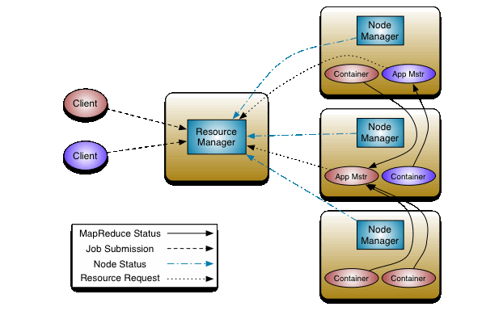
YARN: Architecture

Slide 66
Today’s Agenda
Making Hadoop more efficient
Tweaking the MapReduce programming model
Setup for… What’s beyond MapReduce?

Slide 67

Questions?
Source: Wikipedia (Japanese rock garden)

